Slide 1
NYC Parking Project
BUAD 5272
Team 1
Erica Bucchieri, Zach Pedini, Yannan Zhu, Chris Conlan

Slide 2
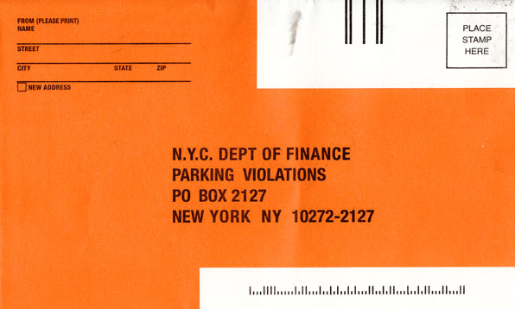
Introduction
$545 million dollars in parking ticket revenue in 2016
Over 80,000 meter spots in NYC
Millions of free spots
Information on where and when parking violations occur is essential
Notes:
Parking tickets are a substantial stream of revenue for the New York City. Amount of money earned in FY 2016, this amount is probably increasing as well. The next closest city to amount of money earned in revenue isn’t even half of what NYC earned. Considering how much money it brings the city, it is important that this process be as efficient as possible. THATS WHERE WE COME IN
-substantial stream of revenue
-over 545 million
-next largest revenue: Chicago
-they need to be as efficient as possible with their ticketing system
-there are over 80,000 metered spots in NYC, important to know where to look and where to allocate time and resources
Licence

Slide 3
Business Question
The New York City Department of Finance would like to increase the efficiency of their ticketing operations by more optimally allocating their efforts and resources to highly ticketed areas.
Notes:
Knowing what areas to focus on and what to look for is going to make the ticketing process for the New York City department of finance more maneagable and efficient.
Our objective was to use alteryx combine the different data sets and clean the data up, then put it through tableau to perform our analysis

Slide 4
Data Acquisition
Main Data Source: NYC OpenData
Data Detail: Parking Violations Issued - Fiscal Year 2020
Sample Size: 4.98M tickets (reduced to 50,000)
43 columns pertaining to the violation (license plate number, where the violation occurred, ect.)
Notes:
The data source we used was parking ticket data from NYC OpenData. This data contains all of the parking tickets from July to October and contains almost 5 million records. FY 2019 there were over 11 million parking tickets given out.For the sake of practicallity we cut it down to 50,000 to make the process much more maneagable. Each of these records contains information on each violation such as the licensplate, vehicle make, where the ticket occurred ect
Parking Violation Codes:
Yankee Data

Slide 5
Dimensions
Violation : violation code, violation description, violation fine amount
Calendar : date and time information
Location : details of the violation location
Vehicle : vehicle make, vehicle model, vehicle year, vehicle color, vehicle registration, license plate number, etc.
Issuer : issuer code, issuer precinct, issuer command, etc.
Fact & Measure
FineAmount :
Ticket Price

Slide 6
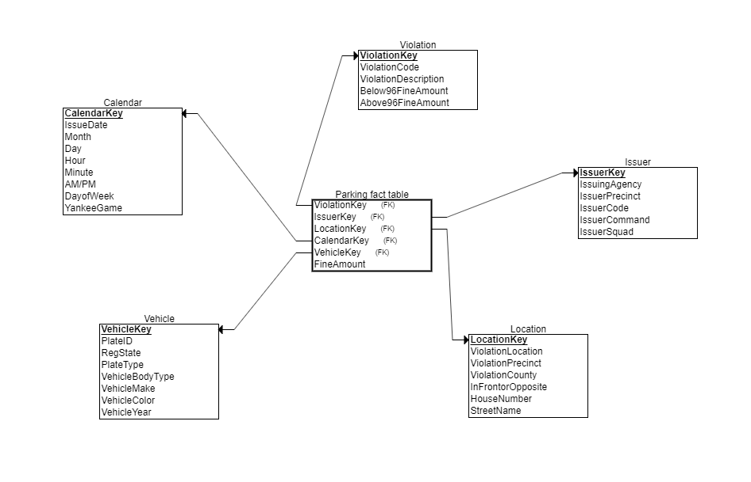
Dimensional Model Diagram

Slide 7
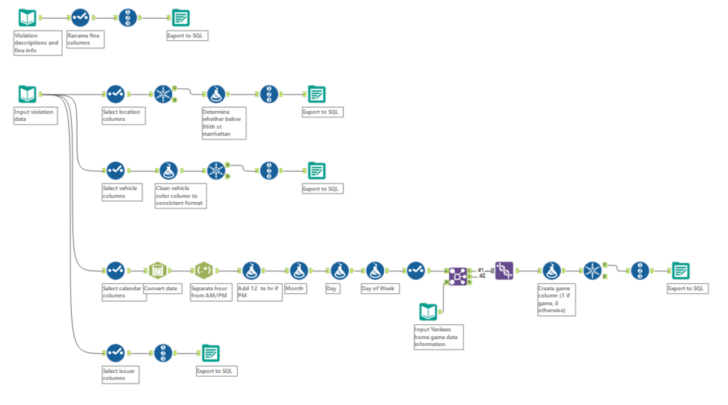
Dimensions

Slide 8
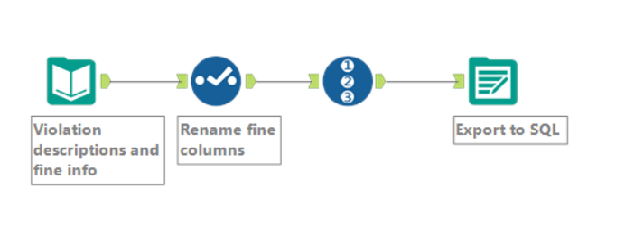
Violation Dimension

Slide 9
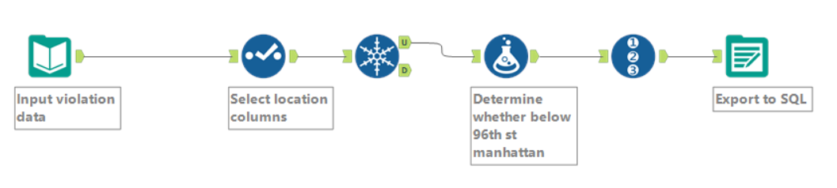
Location Dimension

Slide 10
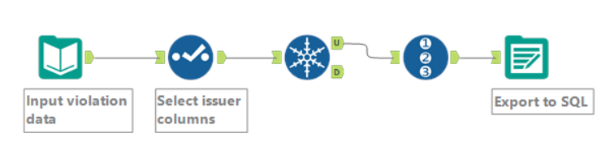
Issuer Dimension

Slide 11
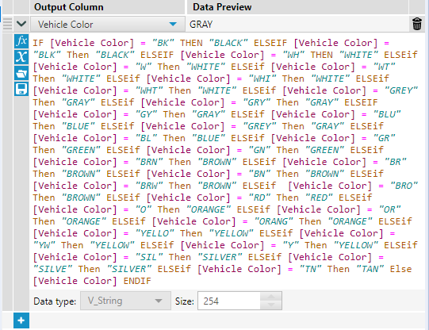
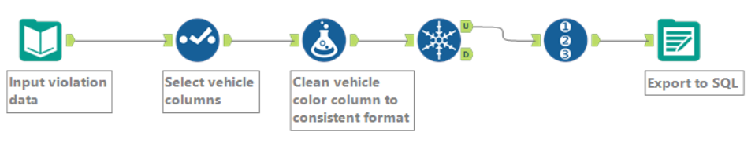
Vehicle Dimension

Slide 12
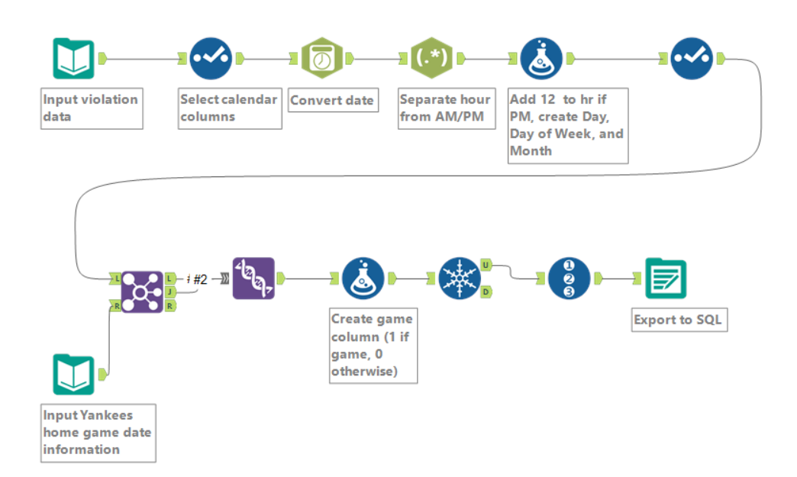
Calendar Dimension
Notes:
Could do which violation type is most common

Slide 13
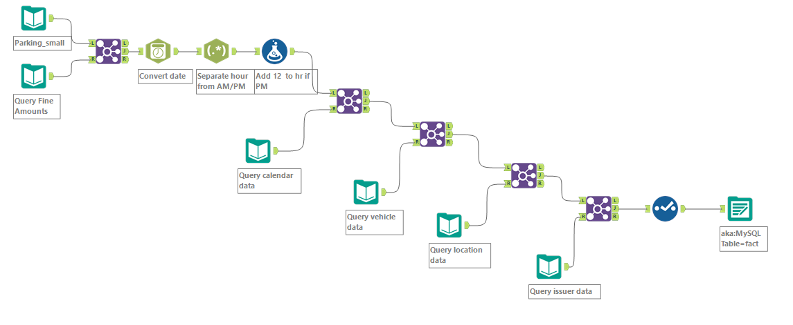
Fact Table Creation

Slide 14
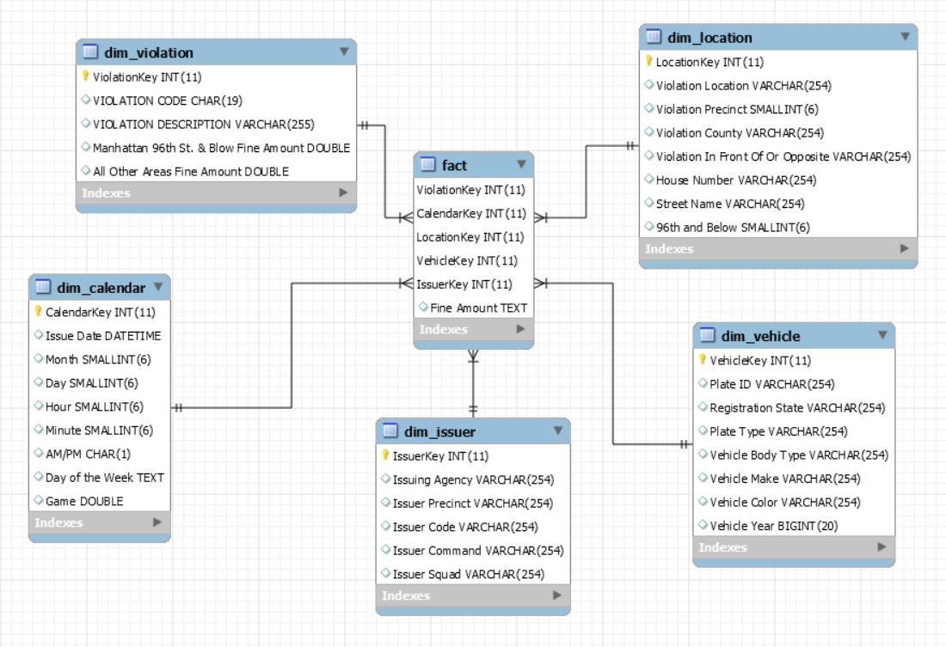
Schema

Slide 15
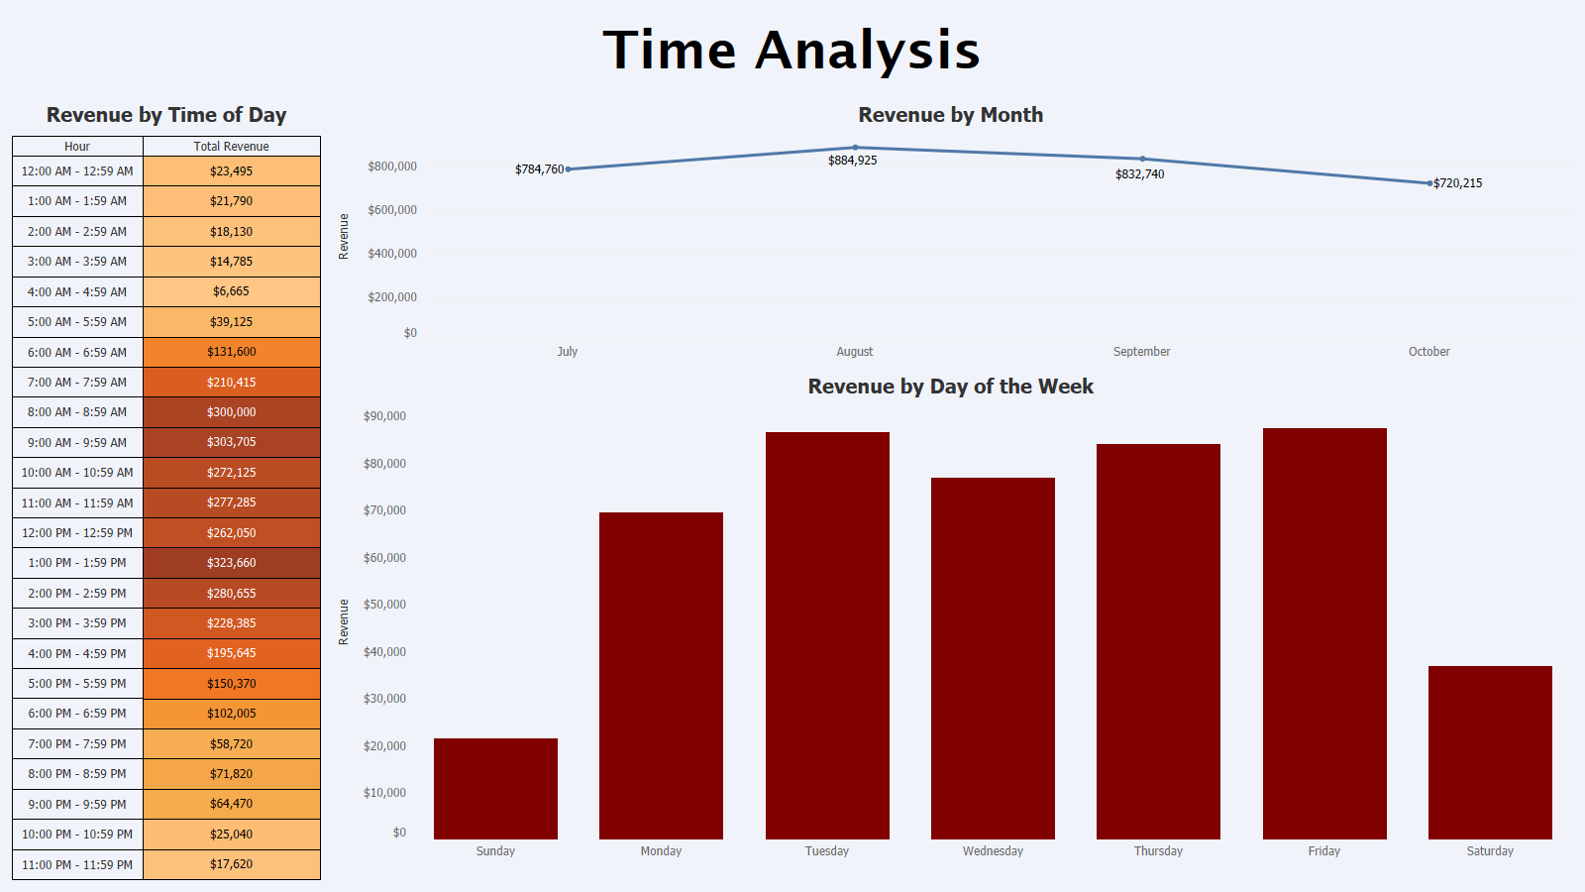

Slide 16
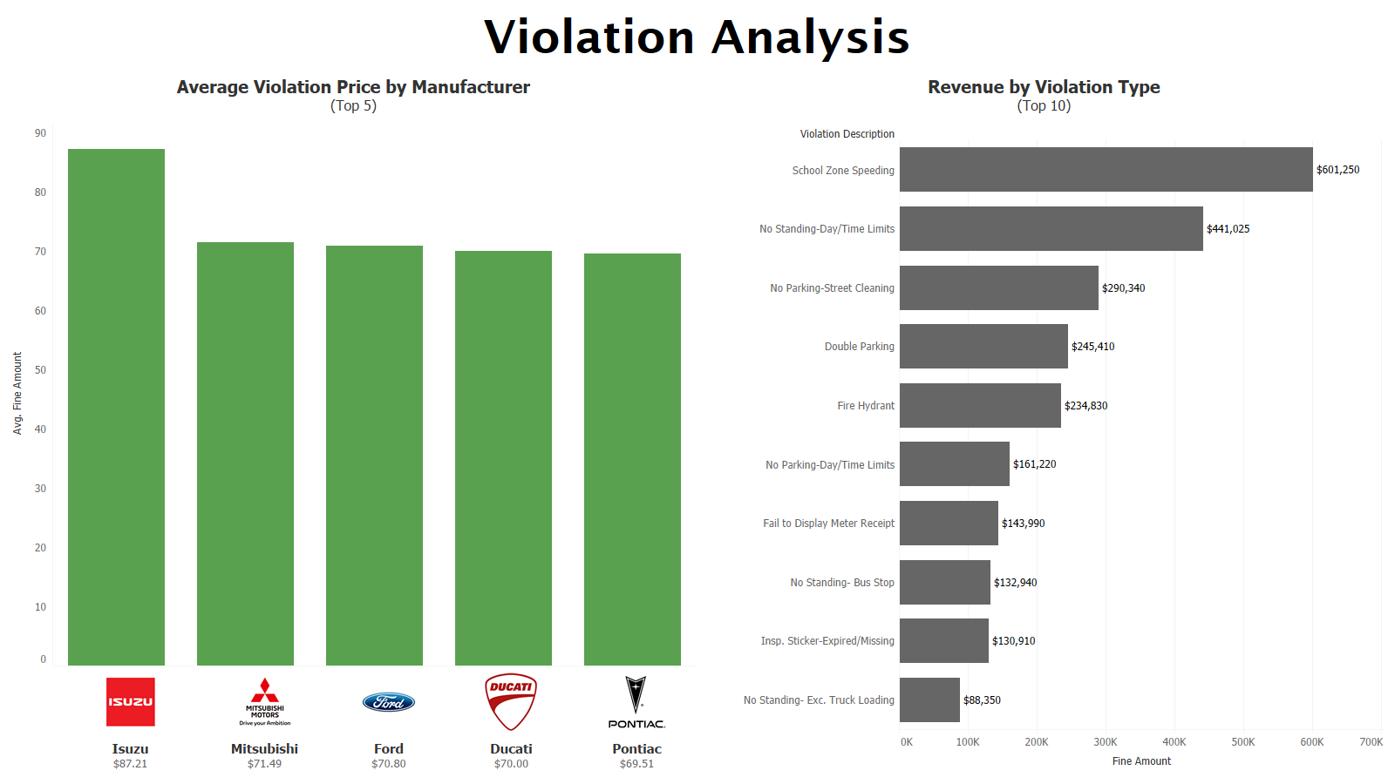

Slide 17
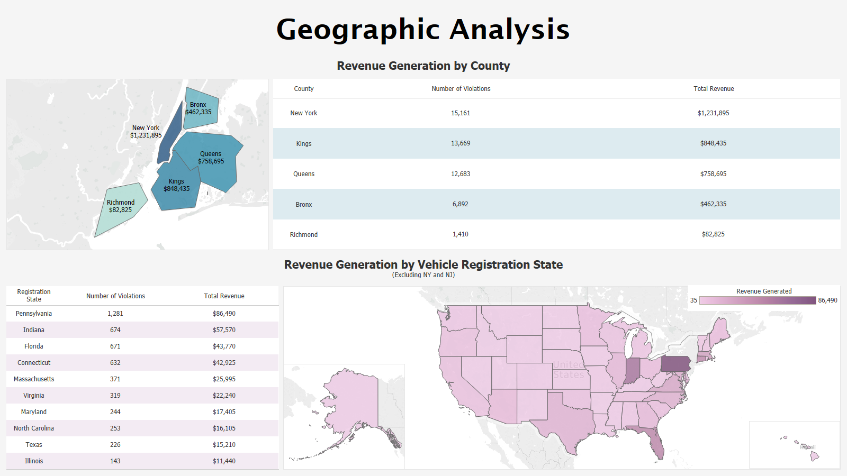
Notes:
Top: New York County has the largest number of violation and highest total rev comparing with other county. Not a surprise since the manhattan area is the most crowded. That indicates the city would monitor and focus on the manhattan area more closely.
Bottom: We continue to analyze the revenue generation by vehicle registration state excluding ny and nj (nyc is located in NY, NJ many people commute from NJ to nyc)Indiana is kind of surprise.Penn, Indiana and florida, conn may indicate many people traveling to nyc that may not realize the parking policies.

Slide 18
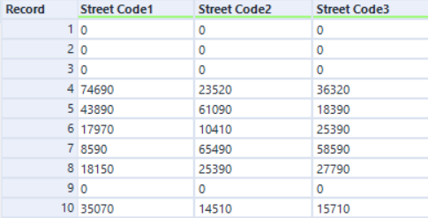
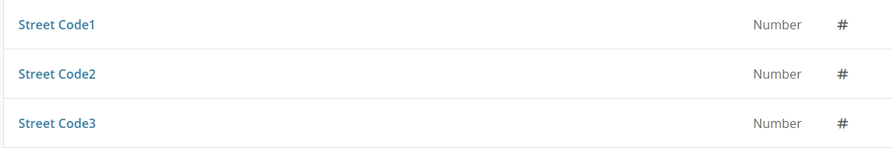
Our Experience with the Project
Difficulties:
Raw dataset is too large and has too many records (4.98M rows).
We thought to use street address to match its latitude and longitude but there is no free resource.
There wasn’t sufficient metadata to understand the attributes. E.g. street code.
Data analysis result may not reflect what we thought initially. E.g. Yankee home game & Bronx
Notes:
Screenshots are example of the street code that are confusing.

Slide 19
Lessons Learned
What We’ll Do Differently:
Pay attention to data integrity throughout the whole process. Make sure our data is mapping in a correct way and have better understanding of connection between attributes.
Considering size of the dimensions when designing dimensions. (Estimate rows before uploading and make sure it is in the right layout)
Involve previous fiscal years’ data to see seasonal and annual trend. (Fiscal year starts every July)
Notes:
We use 2020 fiscal year data most updated data , which started this july.
Overall the raw data is comprehensive.

